Slide 1



Rekursus Umanus

Slide 2
Rekursus umanus importante tanba...
Servisu Rekursus Umanus inklui...
Iha sessaun ne’e, hau espera aprende kona ba...
Notes:
Jogo / brainstorming
Grupos de 4
Depois partilha e resume em quadro branco

Slide 3
Saida deit mak presiza atu halo rekrutamentu?
Oinsaa mak define no
fo’o hatene voluntariu no staff sira nia funsaun?
Saida mak inklui iha ajenda ba briefing molok eventu?
Notes:
Jogo / brainstorming
Grupos de 4
Depois partilha e resume em quadro branco

Slide 4
Oinsaa mak ita jere rekursus umanus?
Nesesidade
Rekruta
Treinamentu
Jestaun
1
2
3
4
Analiza planu no identifika nesesidade ema/funsaun
Rekruta no identifika
ko-organizador
Fo’o treinamentu no briefing
Jere relasaun no fo’o motivasaun no kompensasaun

Slide 5

Ezemplu
Nesesidade
Rekruta
Treinamentu
Jestaun
1
2
3
4
Analiza planu no identifika nesesidade ema/funsaun
Rekruta no identifika
ko-organizador
Fo’o treinamentu no briefing
Jere relasaun no fo’o motivasaun no kompensasaun
Manager SportImpact University
Manager Desportu ba Moris
Veronica
Virginia
On-the-job (train the trainer)
On-the-job – projetu pilotu iha Dili
Formasaun
Salariu
Gastus projetu
Oportunidade servisu ba futuru

Slide 6
Saida mak sai hanesan prosesu ba rekrutamentu?
Define knaar
Buka kandidatu
Simu CV/karta
Halo avaliasaun CV/karta
Hakerek deskrisaun knaar, perfil ba kandidatu, no prosesu rekrutamentu
Tau anunsiu iha jornal, Internet, universidade, nst
Kontata kolega atu husu rekomendasaun ba kandidatu
Analiza esperiensia no kompetensia konforme deskrisaun knaar
Se kandidatura diak, entaun:
Konvida ba entrevista
Halo avaliasaun kandidatu
Hili kandidatu
Asina kontratu
Telefona kandidatu atu marka entrevista
Entrevista kandidatu
Kompara kandidatu hotu no hili kandidatu ne’ebe diak liu ba knaar
Prepara kontratu konforme lei, esplika kontratu ba staff foun no asina kontratu
Notes:
Recruitment is a structured process that involves the steps outlined here. If possible,this process should be followed when recruiting both paid staff and volunteers.
1. Identify needs: This should be done through analysis of the organisation in order to identify numbers required and skills gaps in human resources.
2. Meet needs: Determine the way gaps will be filled, including internal or external recruitment or reorganisation of the service. In addition, determine the
procedures you intend to use.
3. Invite candidates: Communicate your human resources needs internally and externally by appropriate means, such as using an informal network of employees
or advertising, and ask for candidatures to be presented in a standardised format.
4. Receive and evaluate candidates: In general, a first selection is made on the basis of written documents, and the selected candidates are interviewed by
the HR director, the head of the department concerned, and, in smaller OSOs, the president or general secretary. The evaluation should be done against the
skills and knowledge required for the post.
5. Choose candidate: The best candidate is selected collectively by the main stakeholders.
6. Formalise contract: According to labour law, a formal contract or assignment letter is signed by the candidate and the head of the organisation.
7. Hire and integrate: During the first week or month, special treatment to facilitate the smooth integration of new recruits is required to help them to understand their job and the organisation.

Slide 7
Ezemplu husi Desportu ba Moris
MC (Mestre Serimonia)
Manajer ba Protokolu
Manajer ba Muzika
Fo daer diak ba eskola sira
Manajer ba Be’e
Manajer ba Labele Fuma
Animador ba Desportu ida-idak
Manajer ba Fatin
Manajer ba Ekipamentu
Manajer ba Banner
Responsavel Fotografia/Video
Manajer Doadores
Make copies of description of roles in Tetum to distribute here!!!

Slide 8
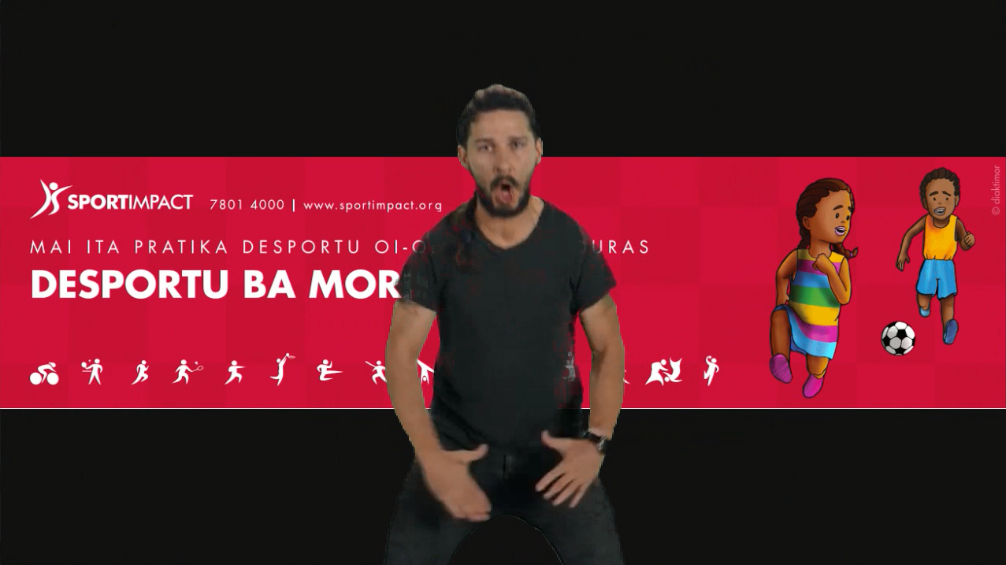
Oinsaa mak garante implementasaun?

Slide 9
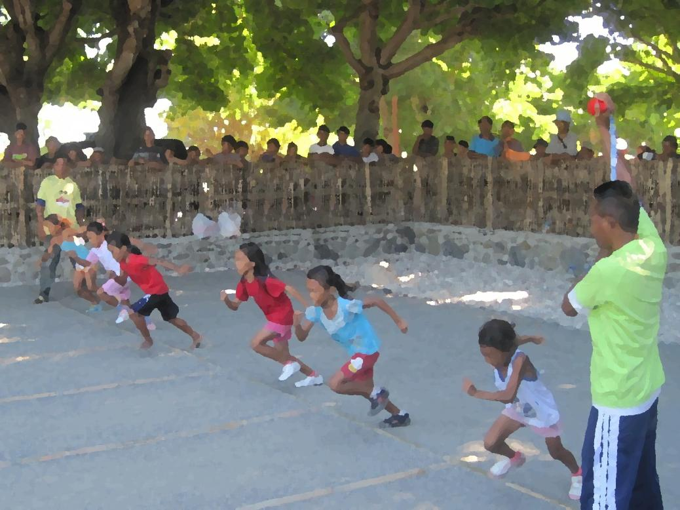

Mai ita pratika!

Slide 10
Servisu grupu: identifika nesesidade
Analiza planu ba imi nia eventu (dader) no identifika nesesidade:
Funsaun/atividade
Ema nain hira
Tempu/durasaun
Analiza planu ba imi nia eventu (dader) no identifika nesesidade:
Funsaun/atividade
Ema nain hira
Tempu/durasaun
Analiza planu ba imi nia eventu (dader) no identifika nesesidade:
Funsaun/atividade
Ema nain hira
Tempo no prazo
Replaced by next slide

Slide 11
Prepara planu rekursus umanus
ba imi nia eventu
Funsaun/knaar
Ema nain hira
Voluntariu ka staff?
Tempu
Manajer eventu
1
Staff
1/Agostu to’o
15 Outubru
Animador ba labarik
10
Voluntariu
20-30/Setembru
nst

Slide 12
Diferensa saida entre
voluntariu no staff?
Voluntariu
Staff
Rekrutamentu
Treinamentu
Jestaun, motivasaun no kompensasaun

Slide 13
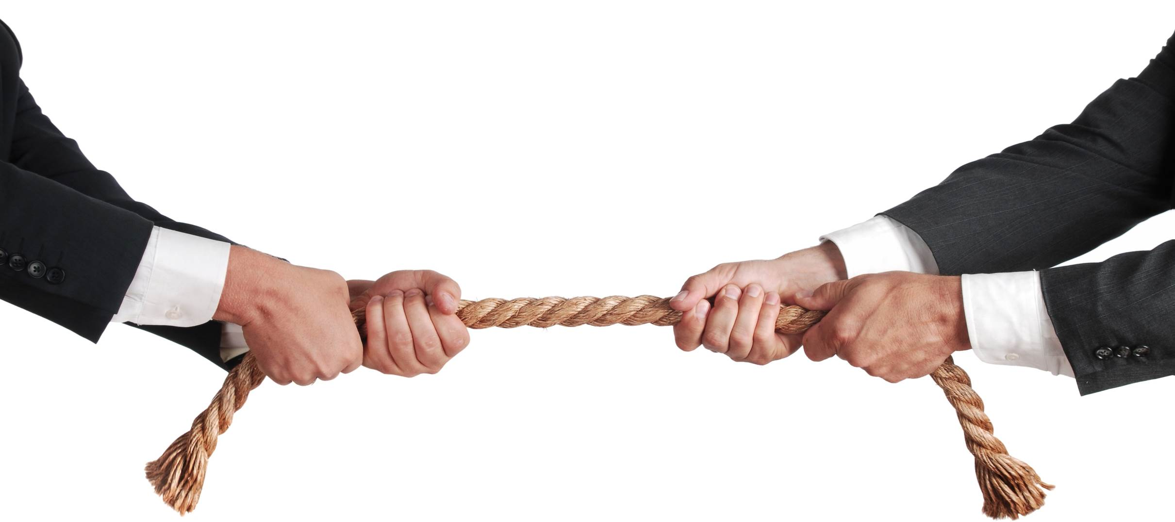
Can also be done with no rope, just holding hands
Notes:
In pairs or groups
Objective: to win
How to win: if you bring the other person/group to the other side of the line between you too
Each person pulling one end of a rope

Slide 14
Saida mak ita aprende kona ba jestaun rekursus umanus?

Slide 15
Rezumu: Jestaun Rekursus Umanus
Nesesidade
Rekruta
Treinamentu
Jestaun
1
2
3
4
Analiza planu no identifika nesesidade ema/funsaun
Rekruta no identifika
ko-organizador
Fo’o treinamentu no briefing
Jere relasaun no fo’o motivasaun no kompensasaun

Slide 16

SERVISU UMA
Lee ’Adapted Sport Manual’ no hetan ideia hodi harii ekipamentu ba desportu
Hetan material (kaixa, bambu, ai, nst) hodi uza aban atu harii ekipamentu ba Desportu ba Moris

